Slide 1
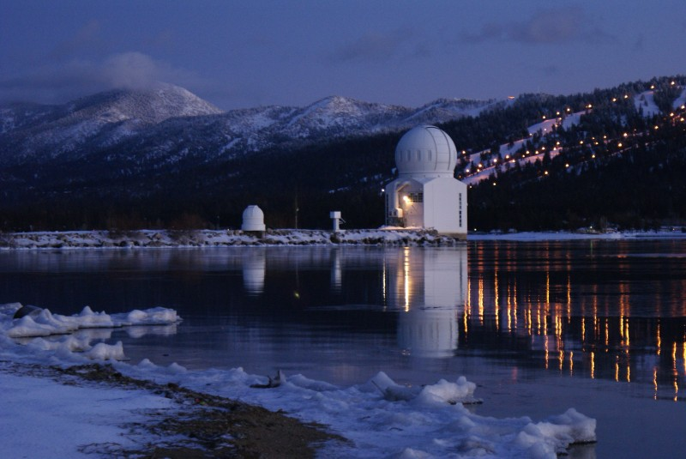
Present and Plans for Adaptive Optics with the 1.6 m Off-Axis Telescope in Big Bear
Philip R. Goode
Vasyl B. Yurchyshyn
Big Bear Solar Observatory
New Jersey Institute of Technology
Notes:
NJIT team has built the world’s largest aperture and most capable solar telescope. The picture is at night and shows our domes with both domes on a 1000 foot long causeway out into the middle of the lake. Winds come from the west with 2 miles of open water to the west minimizing ground layer turbulence with a natural inversion ensuring a laminar air flow to the telescope.

Slide 2
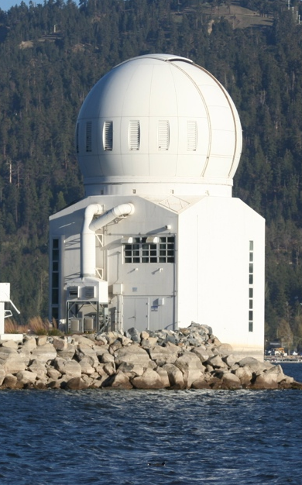
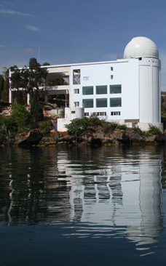
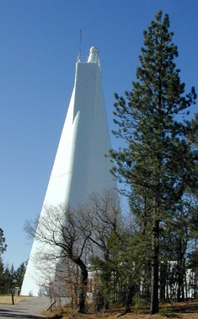
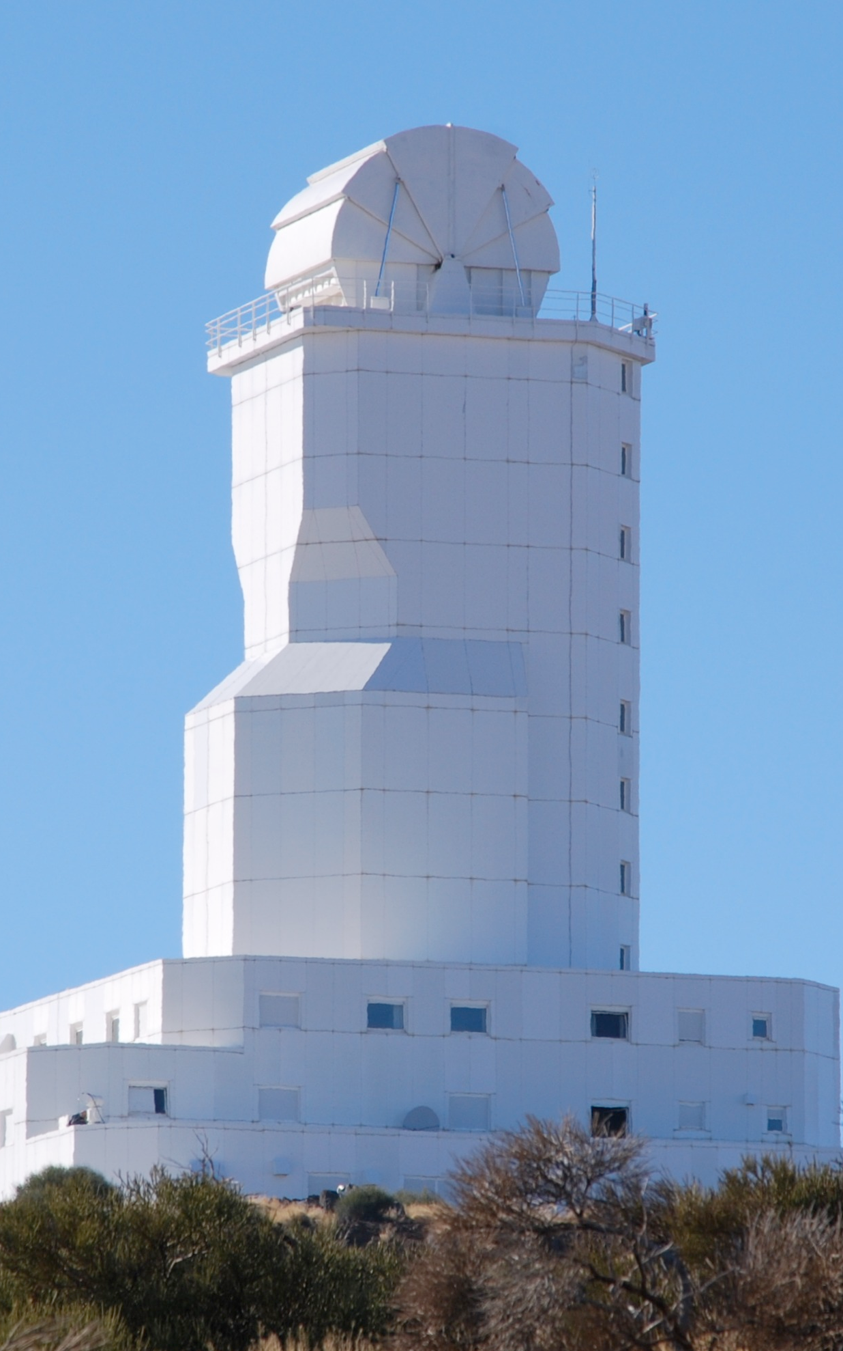

Major operational solar telescopes have AO:
-AO routine for almost all observations
Goode Solar Telescope
Big Bear, USA
1.6 m
8 cm subap.
357 act.
2.2 kHz
highest order
Swedish Solar Telescope
La Palma
1 m
10 cm subap.
85 act.
2 kHz
GREGOR
Tenerife
1.5 m
9.6 cm subap.
256 act.
2.1 kHz
New Vacuum Solar Telescope
China
1 m
8.3 cm subap.
151 act.
3.5 kHz
Dunn Solar Telescope
Sunspot, USA
0.76 m
7.6 cm subap.
97 act.
2.5 kHz
first solar AO
Vacuum Tower Telescope
Tenerife
0.7 m
10 cm subap.
37 act.
2.1 kHz
Dirk Schmidt
All on-axis AO not ground-layer AO
Notes:
All have single DM AO systems narrow field not wide field correction. Practical reason is sub-aperture size. BBSO has GLAO also, GLAO spreads error over field giving wider corrected field but not diffraction limited.

Slide 3
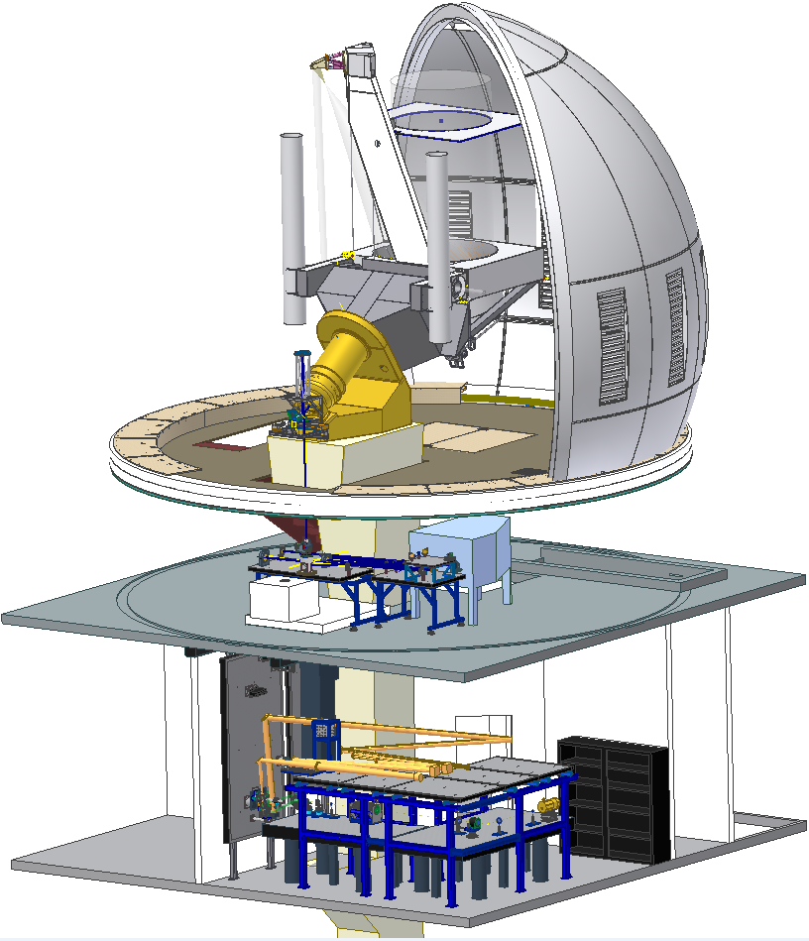
GST Scientific Instruments
Adaptive Optics System
(AO: GenI-III CAO,GLAO & MCAO)
Visible Imaging Spectrometer
(VIS, VISP)
Near InfraRed Imaging Spectro-polarimeters (NIRIS) –
Cryogenic Infrared Spectrograph (CYRA)
Broad-band Filter Imager (BFI)
Fast Imaging Solar Spectrograph (FISS)
CYRA
AO
FISS
BFI
MCAO
VIS
NIRIS
Notes:
3
NST is outfitted with facility-class instruments. Most of these instruments are placed in this Coude Lab, two floors beneath the telescope deck. (This figure shows a cutaway sketch of the NST’s scientific instruments.)
The current NST post-focus instruments include: the AO system, the visible imaging spectrometer, the NIR imaging spectro-polarimeter, the cryogenic IR spectrograph, the broad-band filter imager, and the fast imaging visible spectrograph.
All these instruments can work simultaneously except for the CYRA.
Green means the instrument is operational already, and gray means it is under development.
Here, I will only highlight four of them: AO, VIS, IRIM/NIRIS and CYRA.
(The NST is located on the top-floor telescope deck. Solar light is imaged by PM and SM, then folded through the declination axis by M3 and then directed by M4 along the polar axis down to the telescope Gregorian focus, around here. Relay optics feed light down to the Coude Lab, two floors beneath the telescope deck with the first stop being the adaptive optics.)

Slide 4
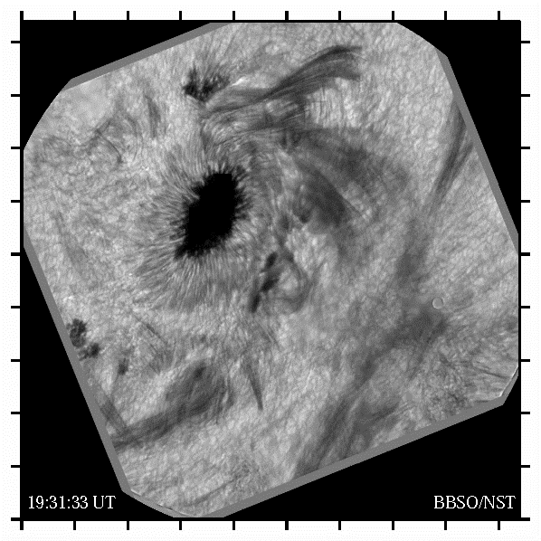
Flare 5 July 2012
1083.0 nm
Nearly 3 hrs
CAO & Speckle
At 21:47 FOV Lit
Need sub-second time-step over FOV
50000 km x 50000 km field
Spot roughly the size of Earth
Notes:
Around 21:50 flaring seems to happen all across the field all at the same time. Images in movie are CAO and speckle corrected.
MCAO is needed to get needed <1 sec cadence on Intensity & B-Field. Further, speckle has problems during dynamical changes.
Movie is Flare_M1.2_20120705-4(converted).mov

Slide 5
All Solar Observatories – 1 DM AO
& Generic Solar MCAO(?):
WFS, DMs, & Guide Regions
Why 3 DMs?
  Rough expectation:
  - One for groundlayer
  - One for transition layer
  - One for jetstream?
How Many Guide Regions are Required?
  FOV & location of turbulent layers
  Use 9 Guide Regions Currently (19 allowed)
WFSs
  Ultimately use only one WFS (not two)
Notes:
Ground level thermals turbulence, wind-shear layer where clouds form and turbulent jet stream, but seems turbulence is continuous and so our system corrects all layers from ground to 11 km with the price being a 35” FOV. Will experiment with widening the field.

Slide 6
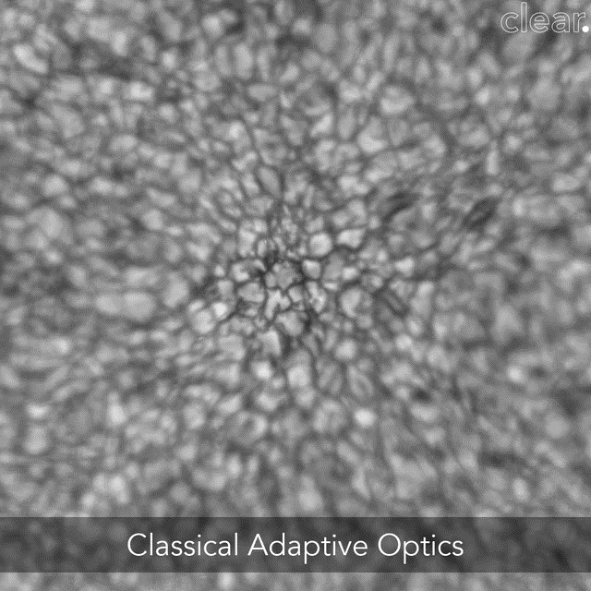
CAO/MCAO 27 July 2016 (53”x53”) TiO (705.7 nm)
Clear: MCAO Pathfinder for Observations of the Sun
Notes:
Movies have no corrections applied – they are raw!
bbso_tio_pcoi_20160727_174945z76_MCAO_CAO_1024x1024_0.20-0.90_reverse_no-glao_gray-1.mp4
July 27, 2016 CAO and MCAO ~150 Frames of each. Burst is 450 frames lasting 31 s
TiO 705.7 nm. This result is repeated over and over. In G-band or with active regions. In fact quiet sun is most impressive because image contrast in guide regions is smaller. The 9 guide regions are automatically selected once target is selected.

Slide 7
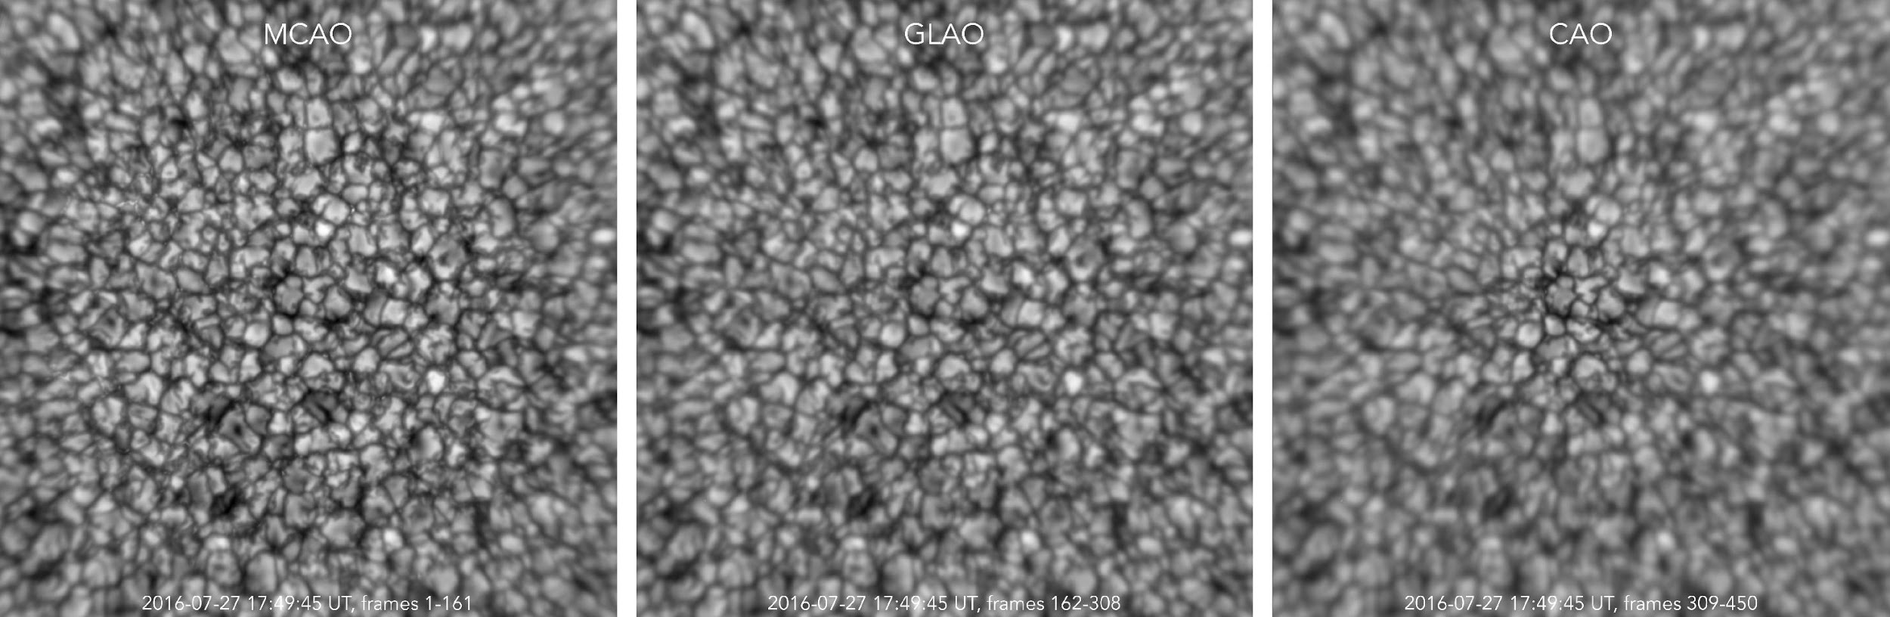
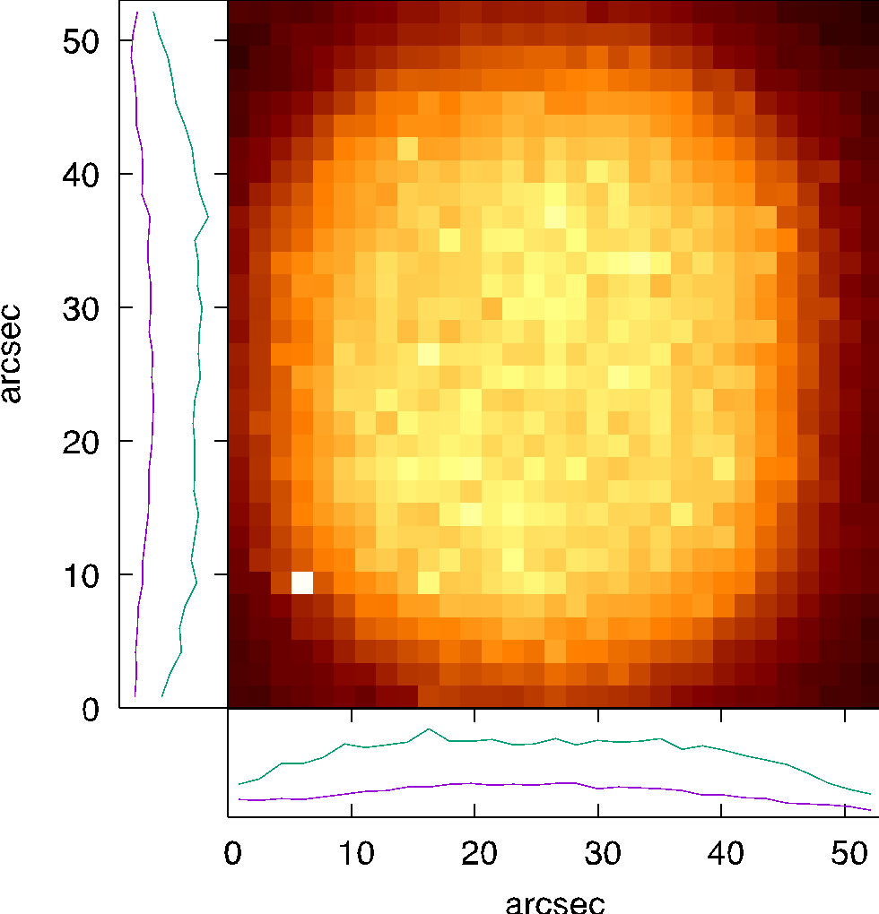
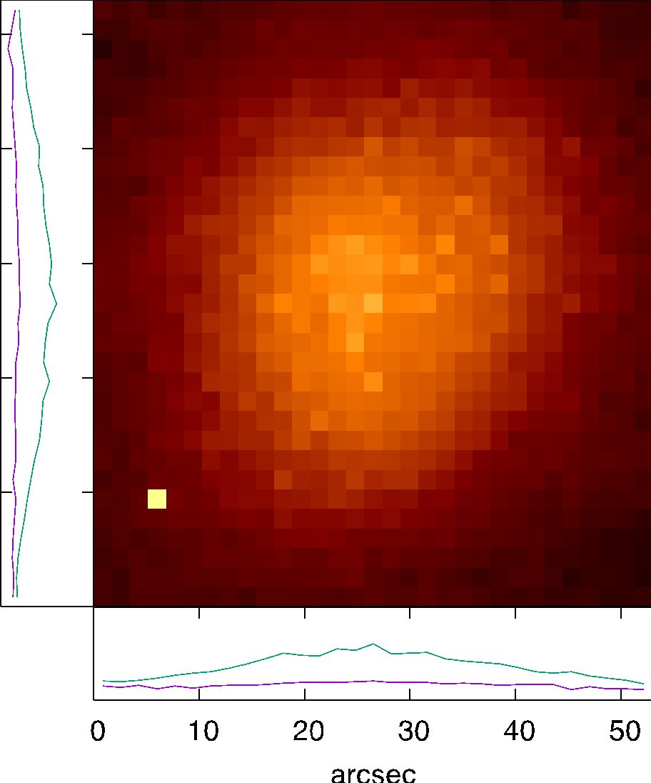
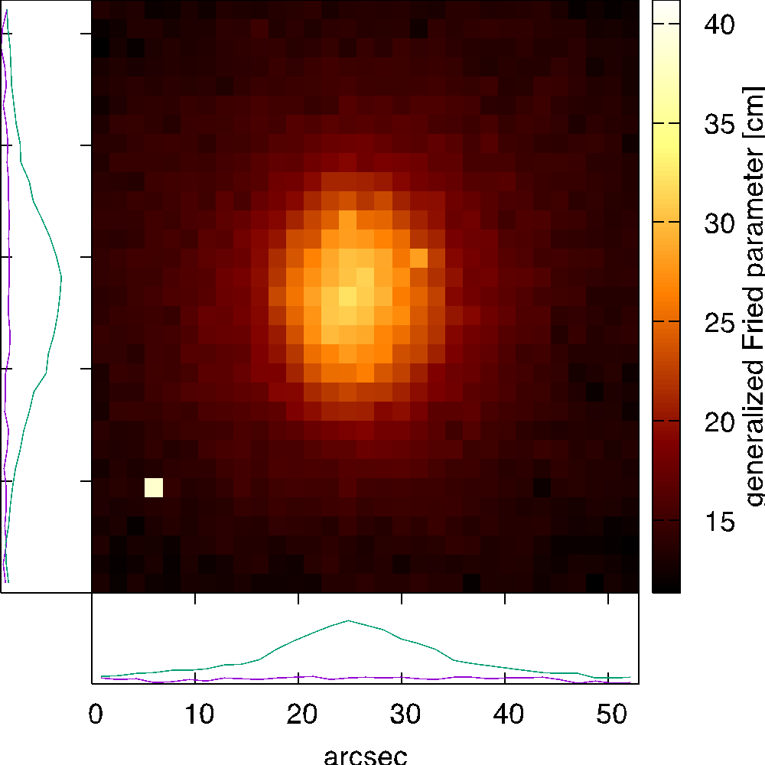
MCAO (53’’x53’’) GLAO (7/27/16) CAO
Notes:
Fried parameter is defined as the diameter of a circular area over which the rms wavefront aberration due to passage through the atmosphere is equal to 1 radian.
The generalized Fried parameter is an estimate of the apparent Fried parameter due to the CAO, GLAO and MCAO corrections.
The Fried parameter is widely used to characterize strength of optical aberrations due to atmospheric turbulence.
KISP uses the Spectral Ratio method to estimate the generalized Fried parameter from the extended solar scenery. This method is sensitive to strong static aberrations, however, unless the static aberrations are strong enough to inhibit the transfer of spatial frequencies lower than those corresponding to $\lambda/\rho_0, the estimates can be used safely to gauge the effectiveness of the correction over the FOV provided by any type of AO system
Yellow is full correction. Note wide field on GLAO (uses the 9 guide regions, but only 1 DM is active). GST has CAO and GLAO as standard instruments and swapping is prompt. Users should experiment.

Slide 8
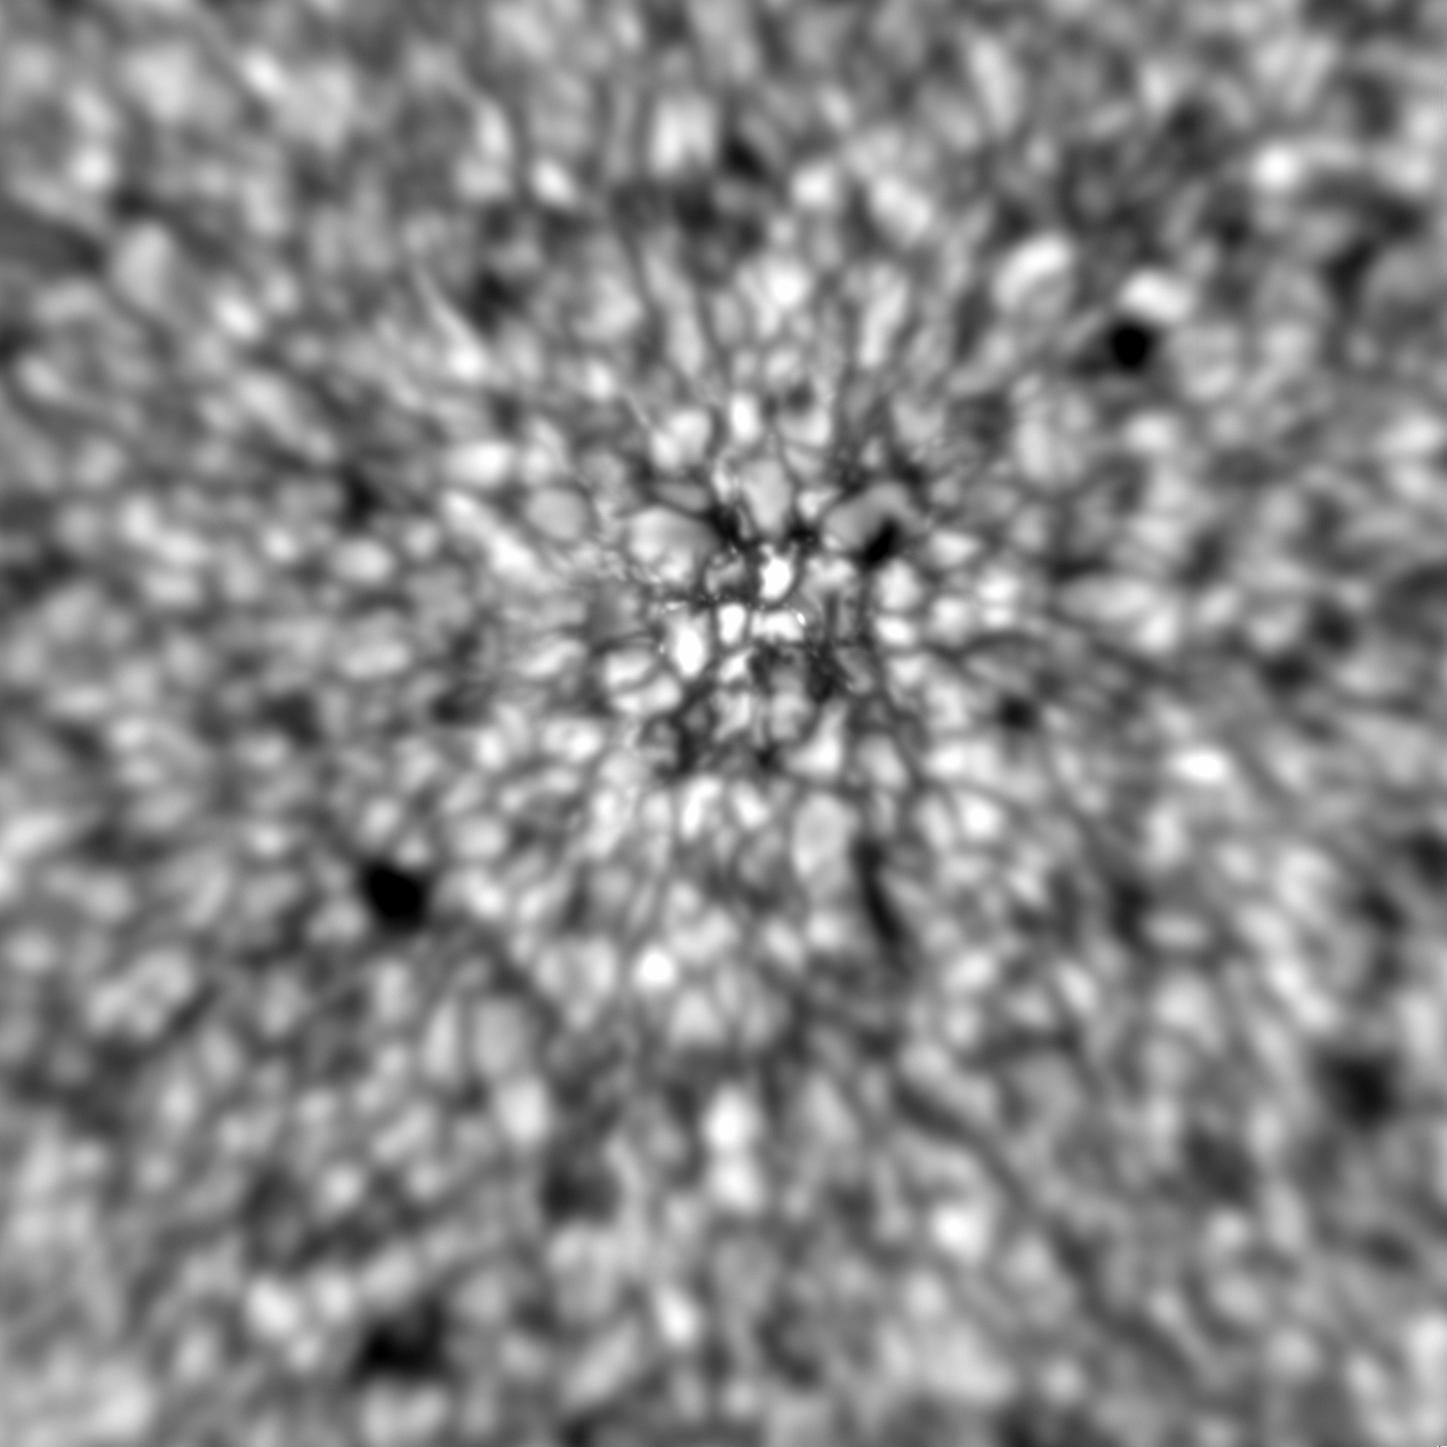
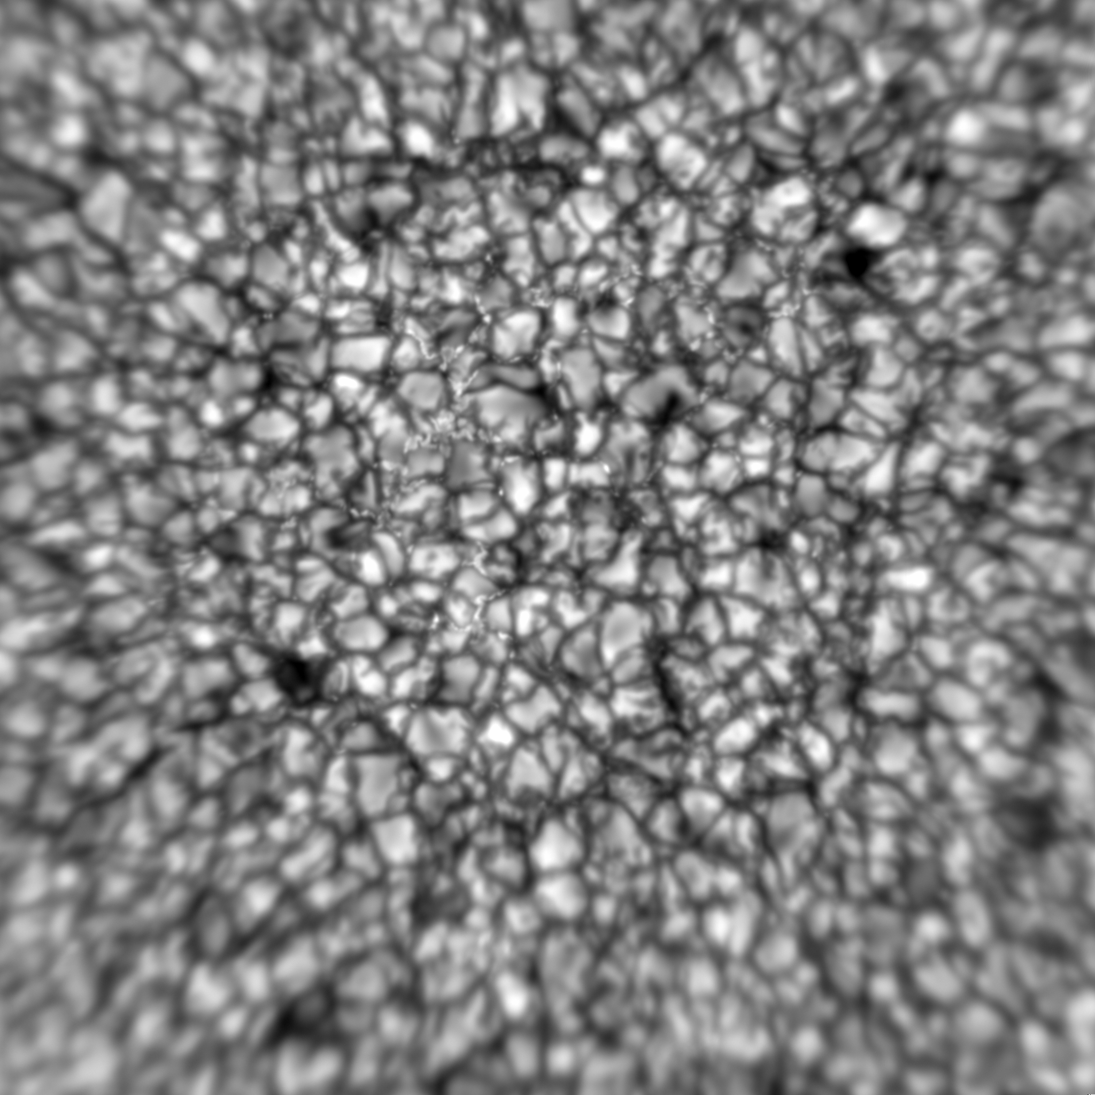
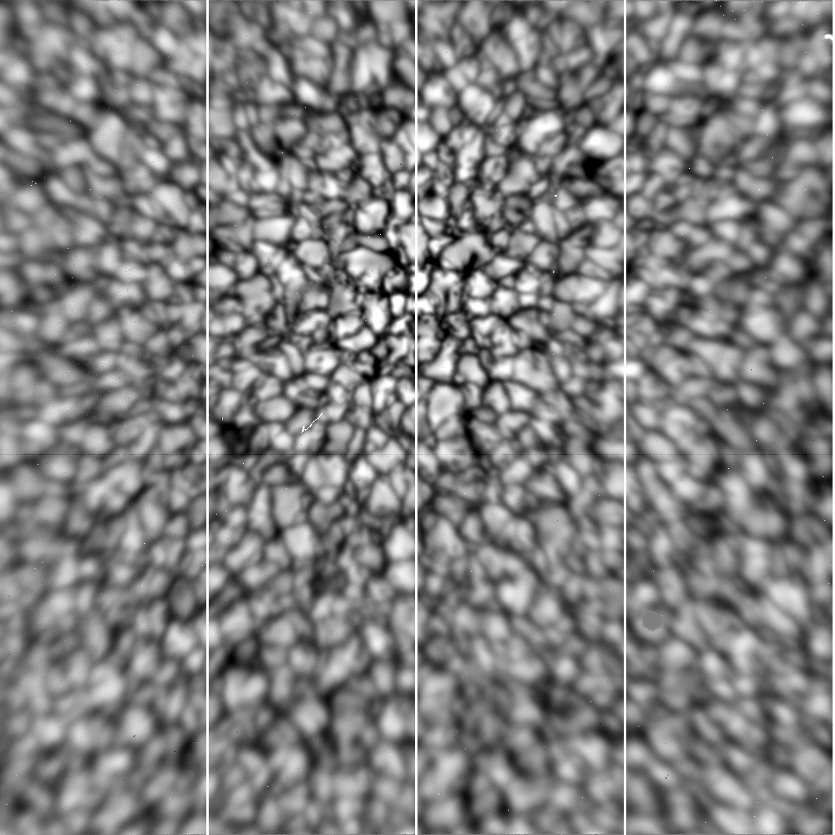
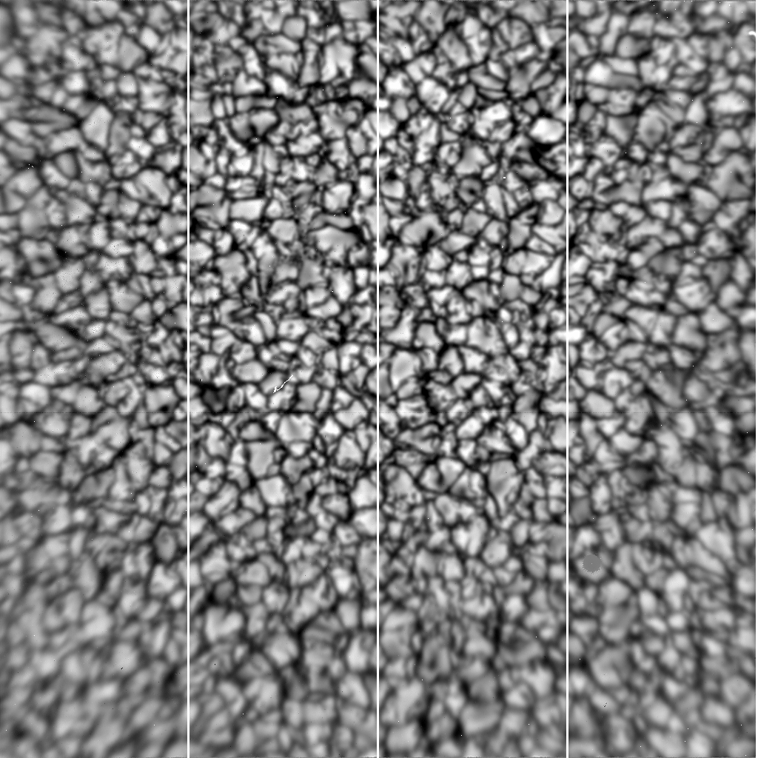
0.7 μm
Vs.
1.56μm
- - Trial Run Data from
10/26/17
0.7 μm CAO
0.7 μm MCAO
1.56 μm CAO
1.56 μm MCAO
Notes:
All four panels here use CAO/MCAO with optics to correct up to 35”, so not a true test of NIR MCAO, but shows that
The seeing is Kolmolgorov.
The two left panels are TiO (0.705 micron). This spectral line intensifies bright points. TiO observations shown
here have a FOV 50’’x 50’’. The two bottom panels show simultaneous NIR observations at 1.56 m. The left hand
panels were obtained using CAO, while the right hand panels come from the same MCAO setup that led
to correcting a 35’’ FOV. A beamsplitter was used for CAO simultaneously with TiO and 1.56 micron and then
switching to MCAO TiO and 1.56 micron, etc. 1.56 micron observations are of special interest because of the presence of the
local g=3 line and the deepest photosphere is revealed in this wavelength regime. The NIR observations use old Rockwell camera and
have a FOV 60’’x 60’’. Each of the four panels is the uncorrected sum of ~150 observations from October 27, 2017 on a day
of mediocre seeing. All four panels have the center of the isoplanatic patch offset upwards to better show the roll-off
in correction with distance from the patch. The vertical lines in the NIR observations are an artifact of read-out in
BBSO’s old 1k1k NIR camera that we used here for ease of operation

Slide 9
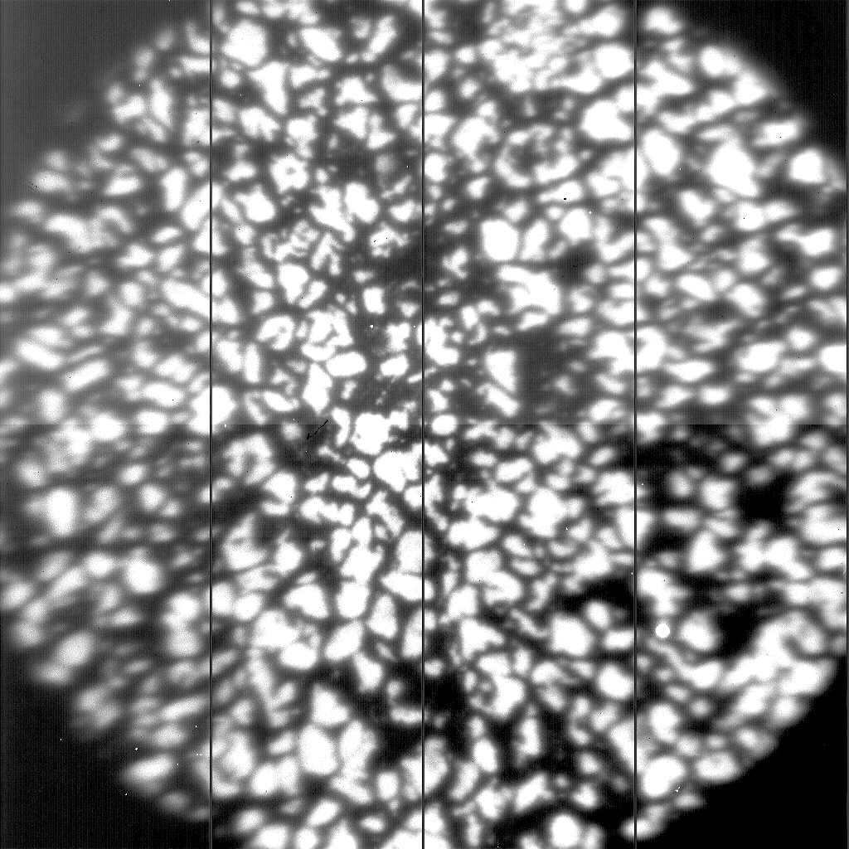
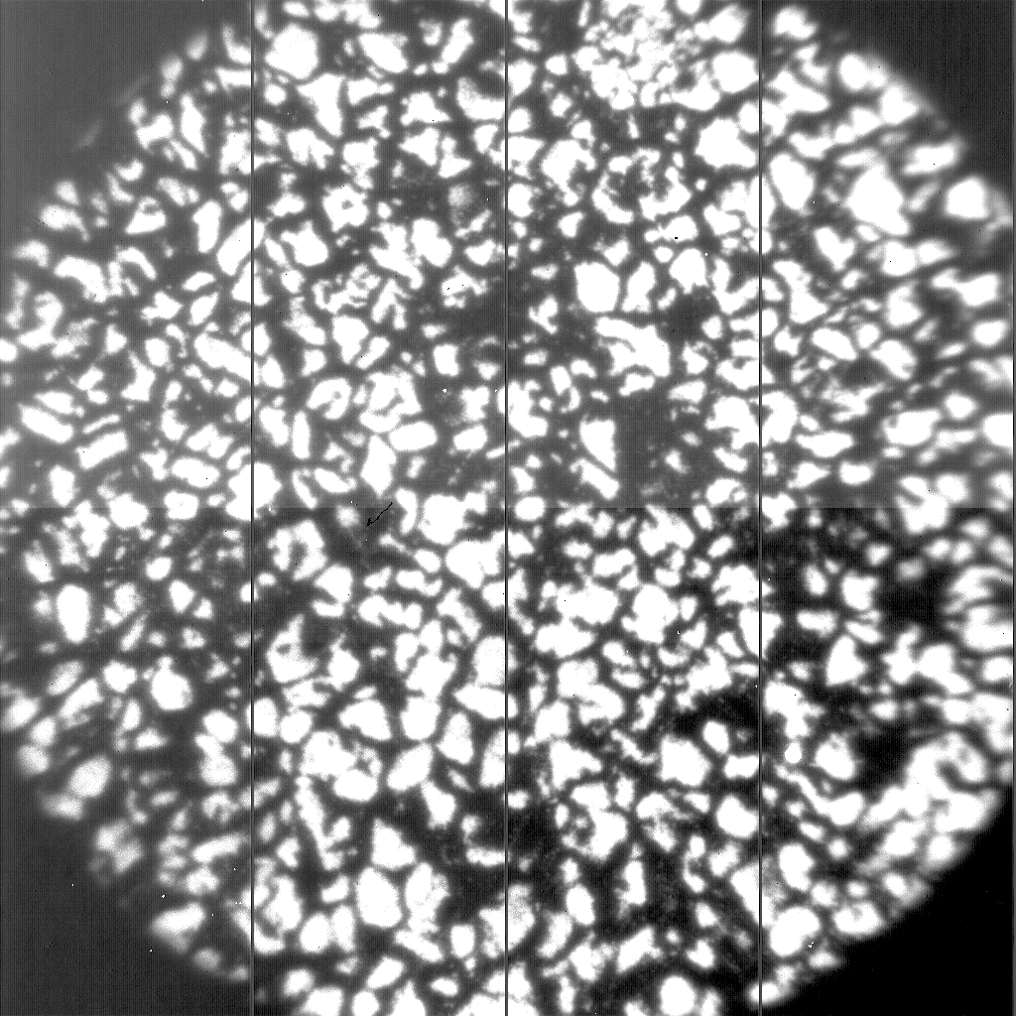
MCAO Lab Tests with 70” Corrected FOV
October 2018 Series
CAO MCAO
Notes:
Superposition of ~150 frames in 1.56 mm light from a lab target of granulation with a cooktop in front of
each DM. CAO is on the left and MCAO is on the right. The optics is for a 70’’ FOV (double size of subapertures) but the camera has a 60’’, hence
the clipping. Nonetheless, lab test are encouraging. We used 55 KL modes on-axis and an additional 22 modes for
wide field, but this was just a quick (and successful) lab test of our NIR-MCAO optical setup.
Can do 10830A as well for chromosphere structures.

Slide 10
Prominence (Ηα) ΑΟ 13 May 2018
Notes:
Superposition of 100 frames of Halpha images corrected by (88 KL modes) Prom-AO from Schmidt et al.
(2018b). Left: Each exposure was 2 ms in duration in the 15 frames/s burst. The data were dark and flat field
calibrated. They were taken on May 13, 2018 on a day of mediocre to poor seeing using VIS with a 50’’x 50’’ FOV.
Right: Beyond tip-tilt (green dots), the clearly apparent AO correction (blue) was largely confined to near the center of the FOV, as one
might expect under the mediocre seeing conditions in effect that day. Nonetheless, the central region had a significantly
improved wavefront correction.
Use CAO: 13 cm subapertureWFS get ~1/3 visible light in 0.07 nm wide filter (S/N ~25 vs 100 for wide field) for WFS. Picked WFS camera for project after trade study of FOV, frame rate and S/N –plenty of light for VIS. Science image is narrow band Halpha on line center.

Slide 11
What’s Coming
Have made Prominence AO Work (October 2018) – let’s use it
Design being implemented to feed current MCAO setup to BBSO spectro-polarimeters in visible and NIR coming
Profiler ready in Summer 2019 in collaboration with Gemini South
Need 2k by 2k WFS camera to use same optical setup for visible in NIR – await technology
More details on MCAO, visit cuna.nso.edu/clear

Slide 12
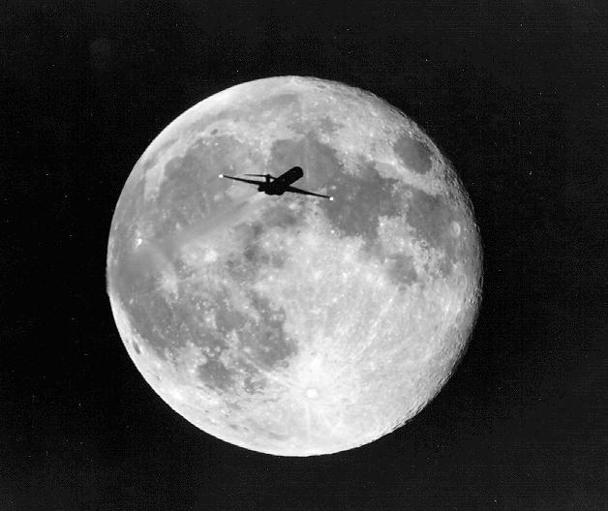
F i n
!
Notes:
Turbulence! One night looking at the Moon a plane flew thru the field of view. Notice how washed out the image is behind the plane.

