Slide 1

New Insights into the Sun’s Photosphere Dynamics Offered by New Solar Telescope of BBSO
Valentina Abramenko,
Vasyl Yurchyshyn, Philip R. Goode
and the NST team
Big Bear Solar Observatory, CA
avi@bbso.njit.edu
Big Bear Solar Observatory
7/02/2011
XXV IUGG/IAGA, Melbourne, Australia

Slide 2
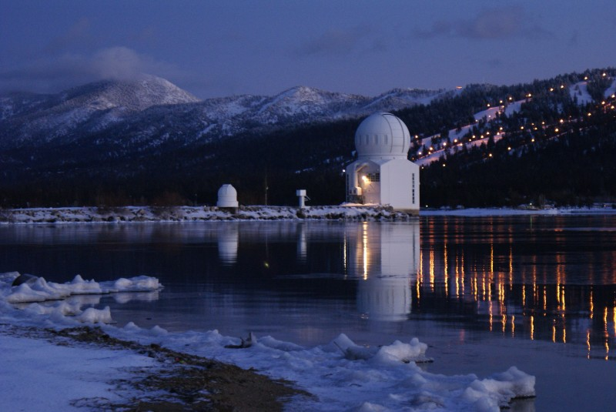
New Solar Telescope at Big Bear
7/02/2011
XXV IUGG/IAGA, Melbourne, Australia

Slide 3
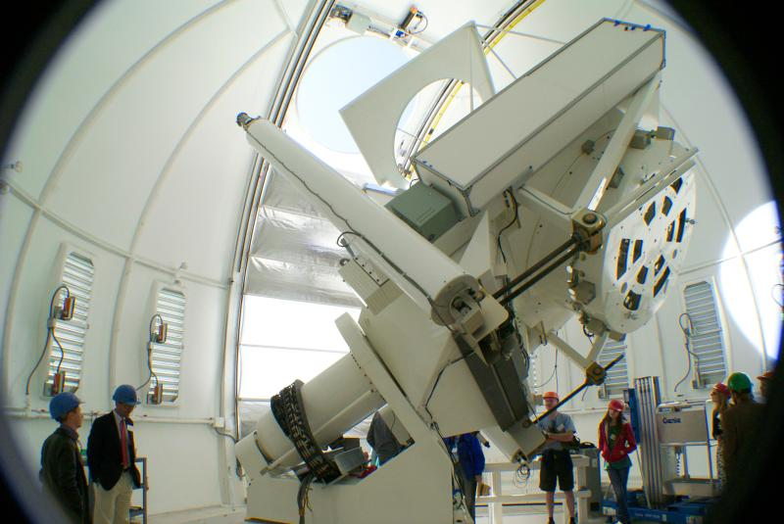
7/02/2011
XXV IUGG/IAGA, Melbourne, Australia

Slide 4
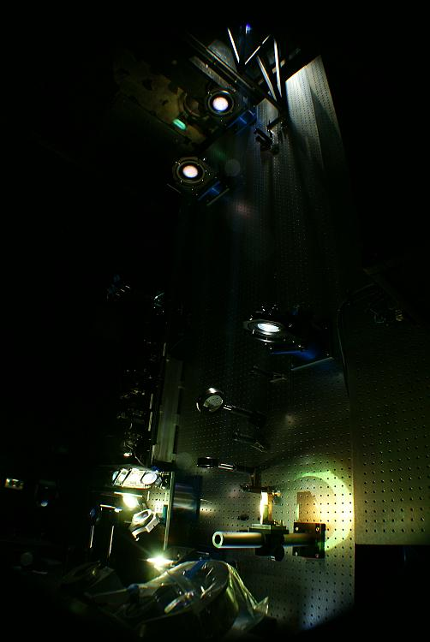
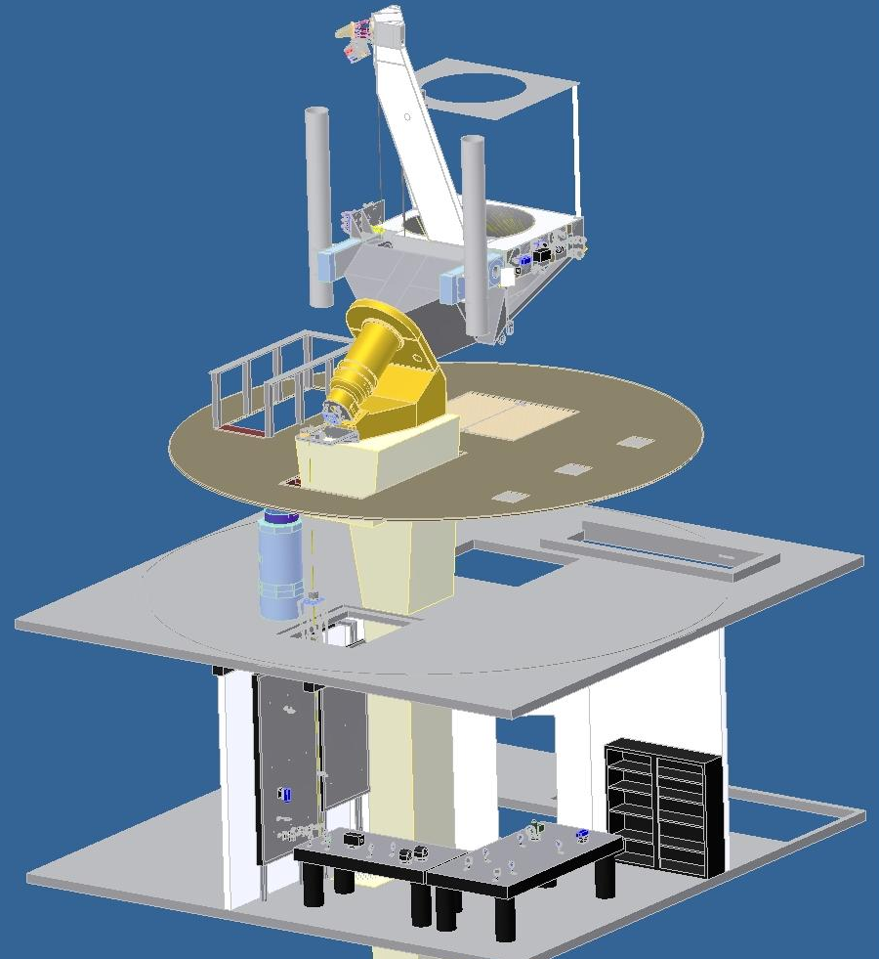
Coude room optical layout
7/02/2011
XXV IUGG/IAGA, Melbourne, Australia

Slide 5
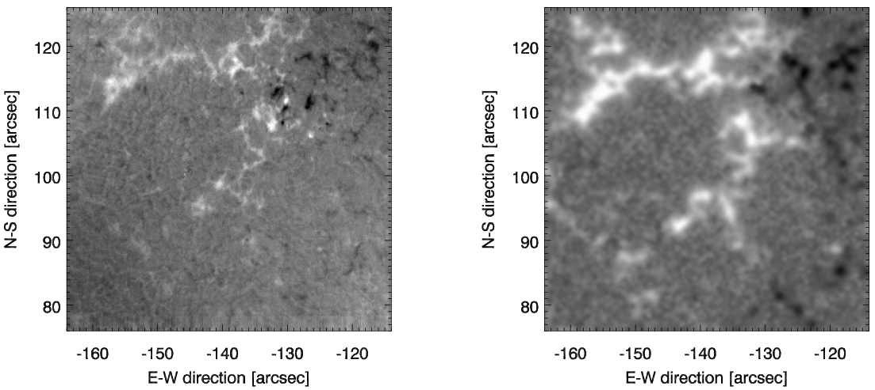
Magnetic Fields Measurements from NST and SDO
NST InfraRed Magnetogram
SDO magnetigram
7/02/2011
XXV IUGG/IAGA, Melbourne, Australia

Slide 6
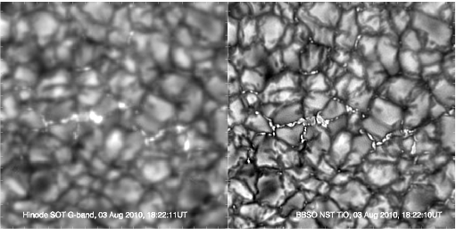
Hinode Satellite (Left) and NST (Right) Images of the Sun the Same
Time/Place (Abramenko et al. 2010, ApJL, 725)
Hinode/G-band
NST TiO
7/02/2011
XXV IUGG/IAGA, Melbourne, Australia

Slide 7
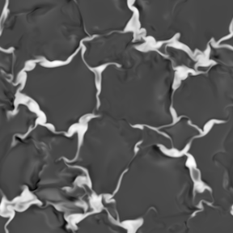
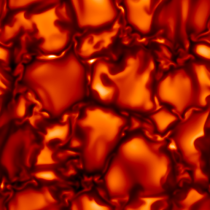
Bright points (magnetic flux tubes) are NOT ribbons, but always form
chains of beads

Slide 8
NST observations verify simulations of granula evolution :
formation of bright granula lane moving inside the granula
is accompanied by emergence of horizontal rotating vortex tube
and tiny jets (Yurchyshyn et al. 2011 ApJL, accepted)
7/02/2011
XXV IUGG/IAGA, Melbourne, Australia

Slide 9
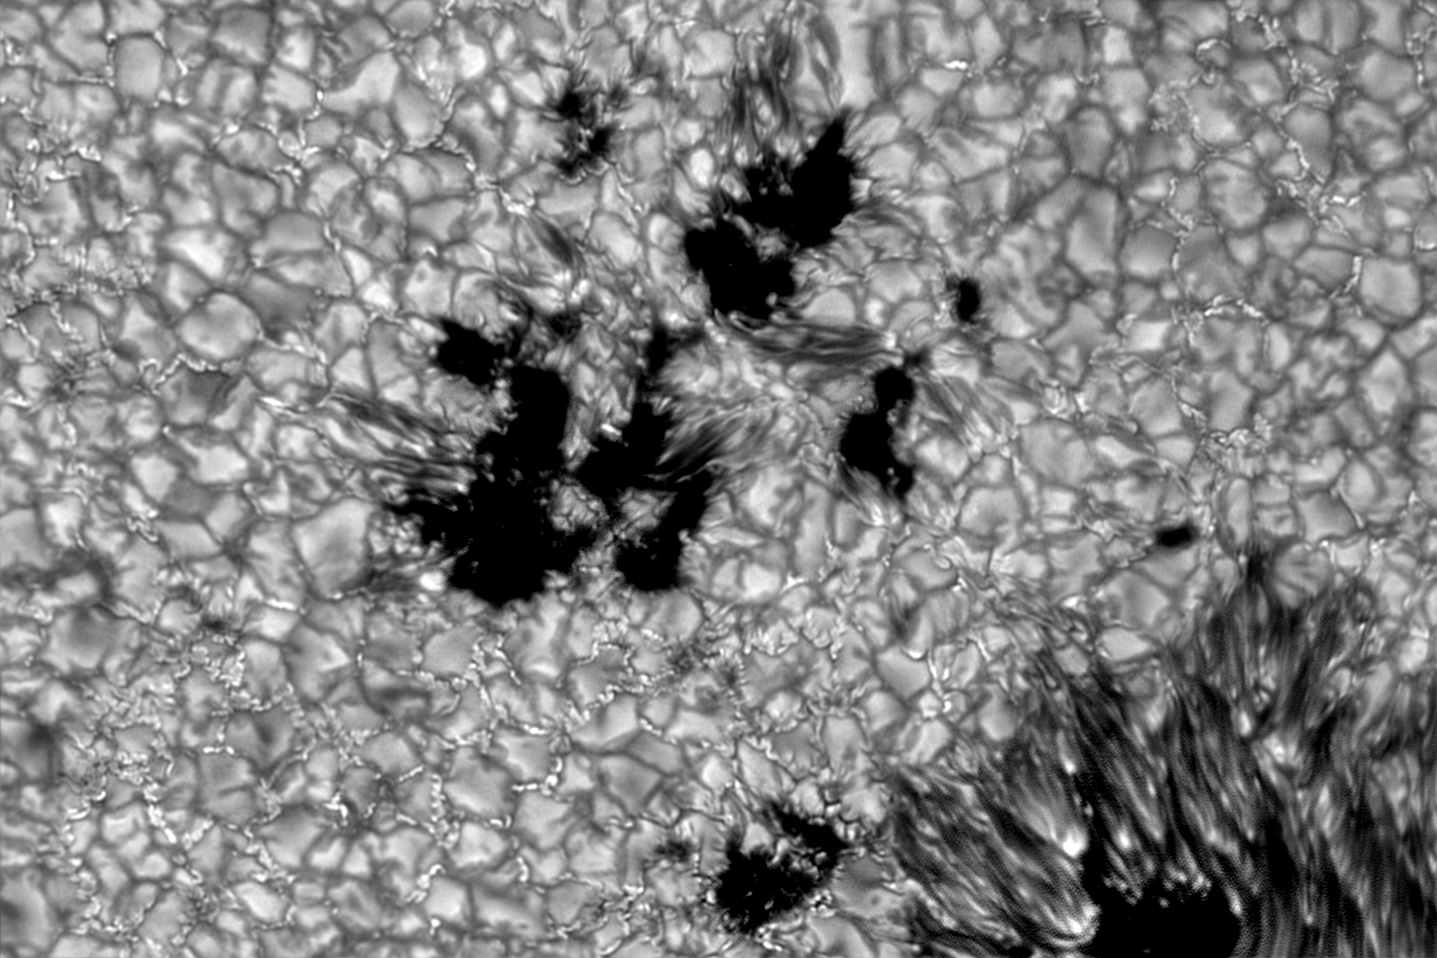
Pores and penumbra formation , photospheric signatures
of flux emergence (Lim et al, ApJ submitted)
7/02/2011
XXV IUGG/IAGA, Melbourne, Australia

Slide 10
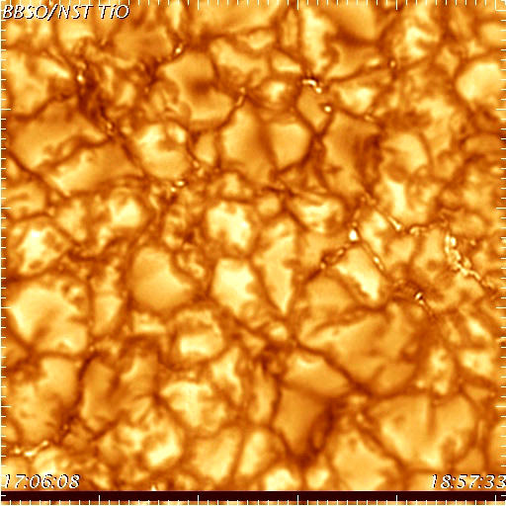
Dynamics and statistics of photospheric bright points (BPs)
A set of 648 TiO images:
AO corrected
Speckle reconstructed
Aligned
Destretched
Image size: 14 x 14 Mm,
or 510 x 510 pixels
Cadence 10 s
17539 BPs were detected and
tracked
7/02/2011
XXV IUGG/IAGA, Melbourne, Australia

Slide 11
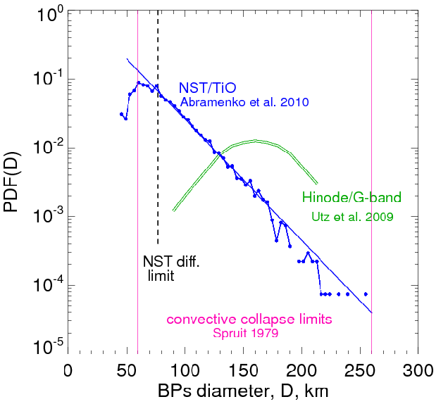
Size distribution of BPs: minimum size of flux tubes is not reached yet
(Abramenko et al. 2010, ApJL, 725)
77 km
7/02/2011
XXV IUGG/IAGA, Melbourne, Australia

Slide 12
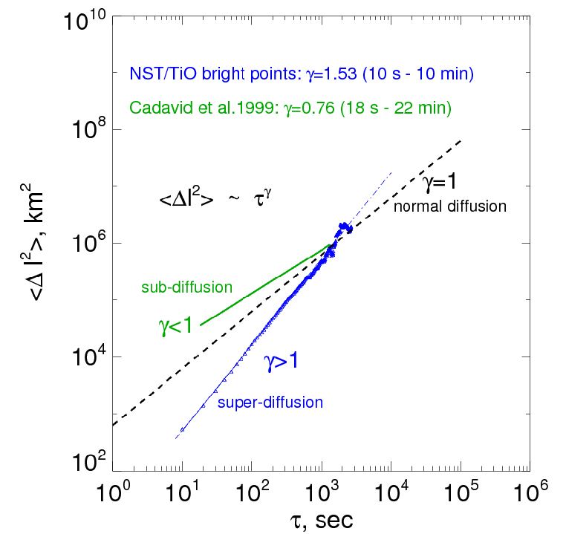
Magnetic diffusion in the photosphere occur in a super-diffusion regime
on scales below 600 km and shorter than 10 min
(Abramenko et al. under preparation)
Details: Tuesday, Jul 5,
16:30 talk in this room
7/02/2011
XXV IUGG/IAGA, Melbourne, Australia

Slide 13
7/02/2011
XXV IUGG/IAGA, Melbourne, Australia

Slide 14
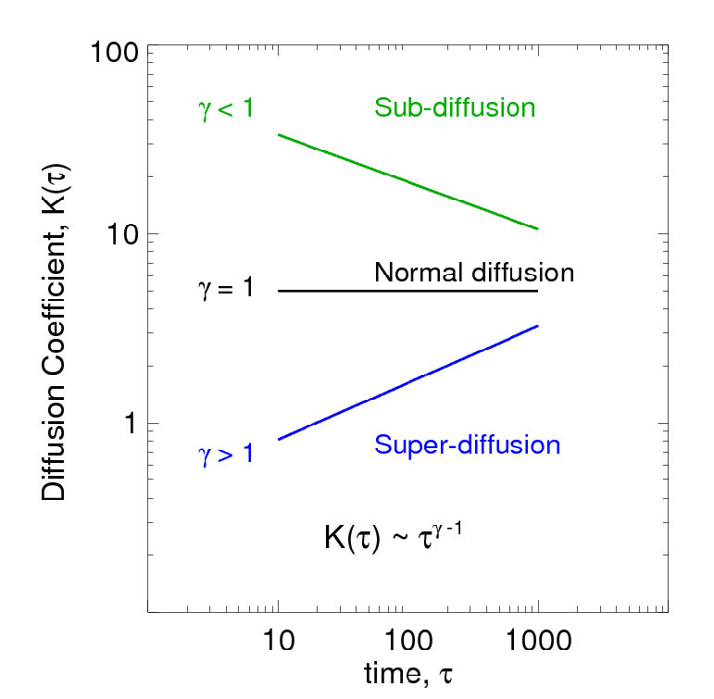
Diffusivity: some definitions:
7/02/2011
XXV IUGG/IAGA, Melbourne, Australia

Slide 15
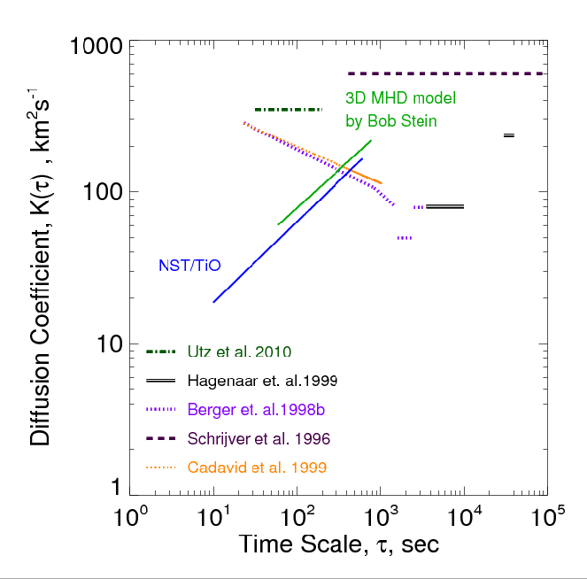
Details: Tuesday, Jul 5,
16:30 talk in this room
7/02/2011
XXV IUGG/IAGA, Melbourne, Australia

